Slide 1


APSSDC (IoT with Raspberry Pi)

Slide 2

Raspberry Pi

Slide 3
What isRaspberry Pi
The Raspberry Pi is a low cost, credit-card sized computer that plugs into a computer monitor or TV, and uses a standard keyboard and mouse.
The Raspberry Pi was created in Febuary 2012 by the Raspberry Pi Foundation
Official site: www.raspberrypi.org

Slide 4
Arduino & Raspberry Pi Differences
SL No. | Raspberry Pi | Arduino
1 | It is a mini computer with Raspbian OS. It can run multiple programs at a time. | Arduino is a microcontroller, which is a part of the computer. It runs only one program again and again.
2 | It is difficult to power using a battery pack. | Arduino can be powered using a battery pack.
3 | It has 64 Bit Processor | It has 8 Bit Controller
4 | It has 900MHz Processor, (1.2GHz for Pi 3) | It has 16MHz .
5 | It is expensive | It is available for low cost.
6 | Raspberry Pi can be easily connected to the internet using Ethernet port and USB Wi-Fi dongles. | Arduino requires external hardware to connect to the internet and this hardware is addressed properly using code.

Slide 5
Raspberry Pi Models
Raspberry Pi 3 Model B
Raspberry Pi 2 Model B
Raspberry Pi 1 Model B+
Raspberry Pi 1 Model B
Raspberry Pi 1 Model A
Raspberry Pi 1 Model A+
Raspberry Pi Zero W
Raspberry Pi Zero

Slide 6
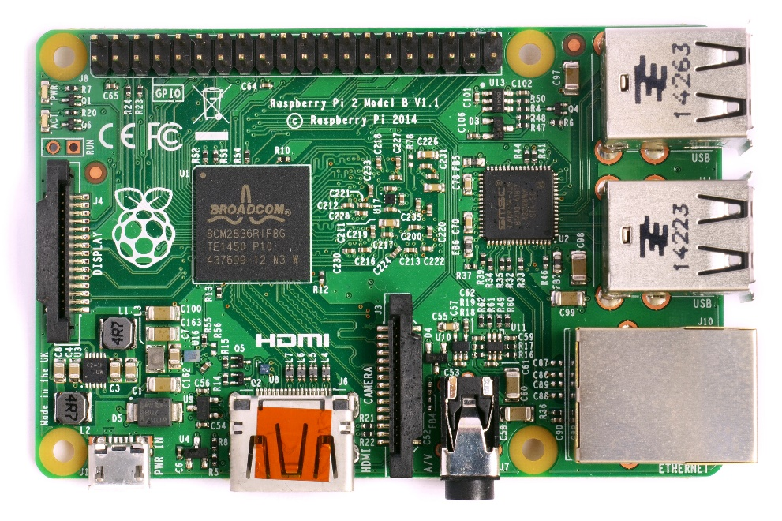
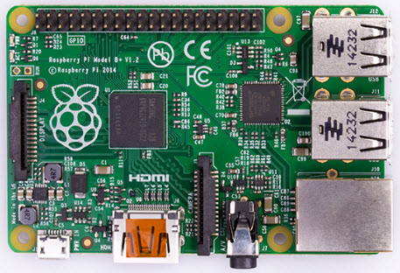
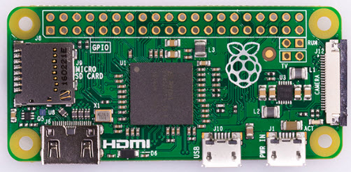
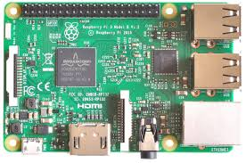
Raspberry Pi Models

Slide 7
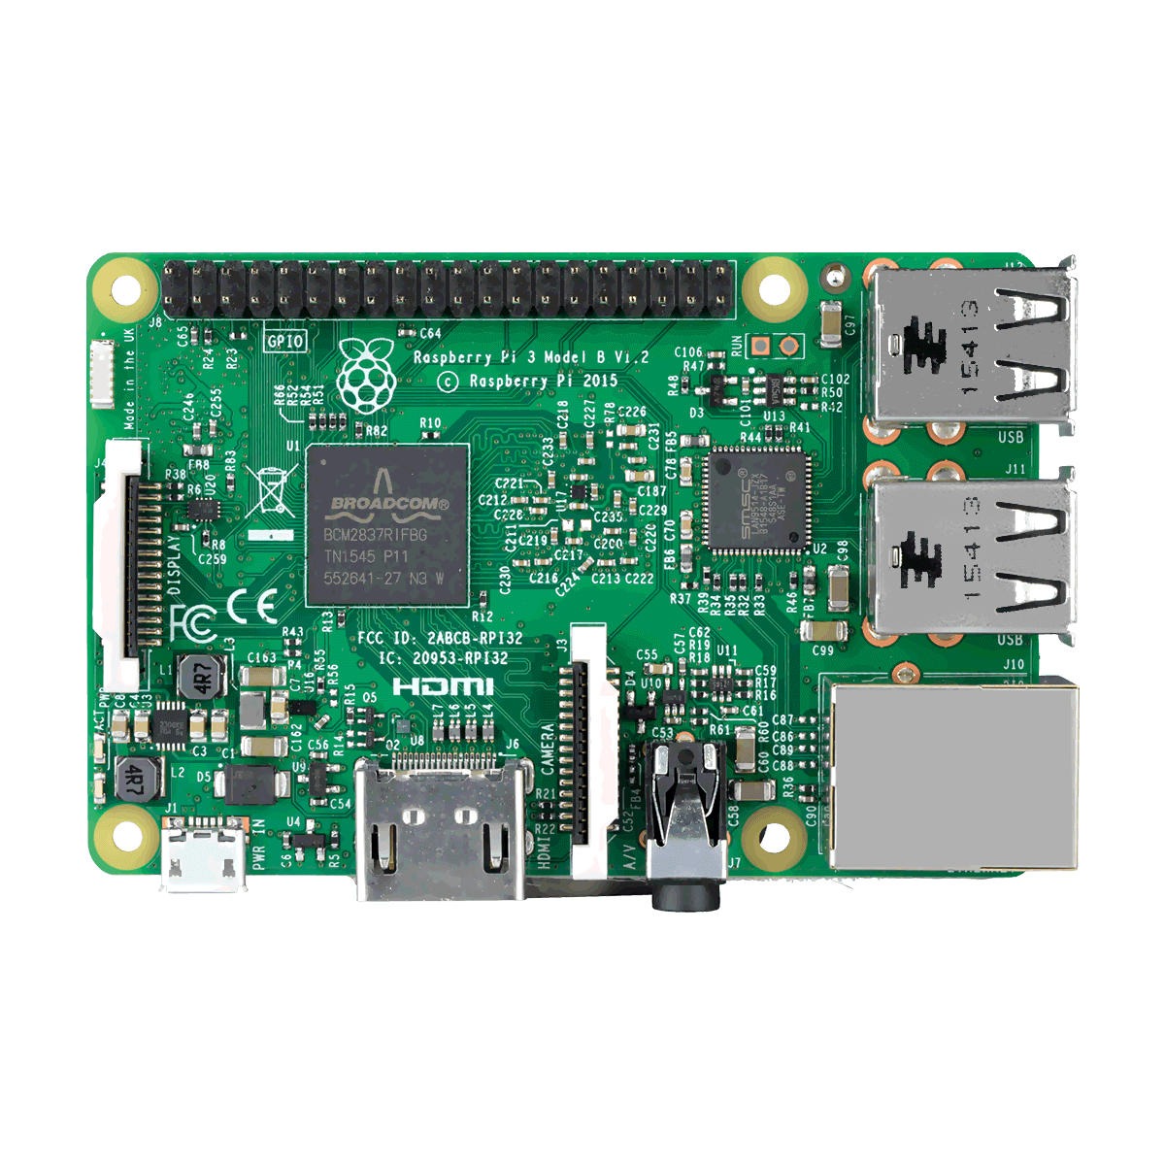
Raspberry Pi 3 Technical Specifications
64-bit quad-core ARMV8 CPU 1.2GHz
1GB RAM
Onboard WIFI - BCM43143
Bluetooth 4.1 (Bluetooth Low Energy - BLE)
40 Pin GPIO
4 USB-2 ports
4-pin stereo output and Composite video output
Full HDMI Port
Raspberry Pi camera port CSI
Raspberry Pi 7"" touch screen display port
Micro SD Socket
Updated power up to 2.5 amp
Power and Actions indications LEDs

Slide 8
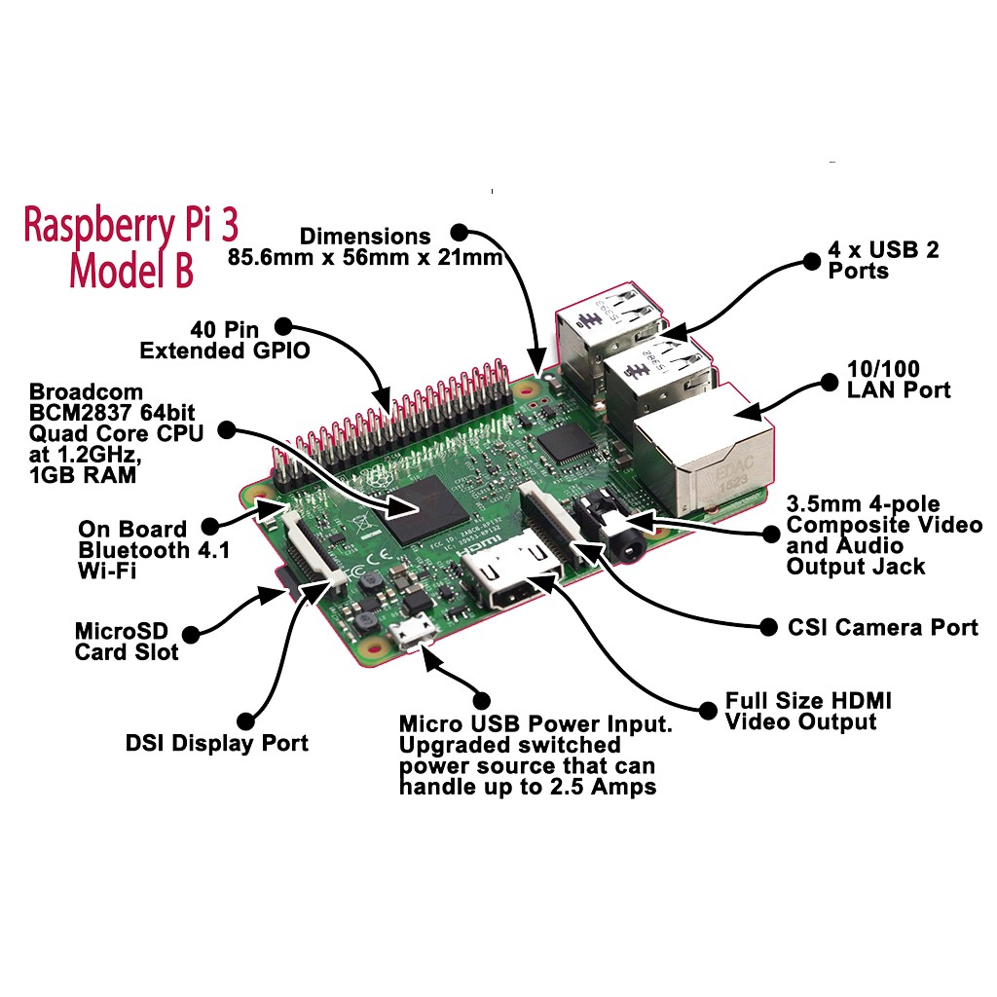
Raspberry Pi 3 Model B

Slide 9
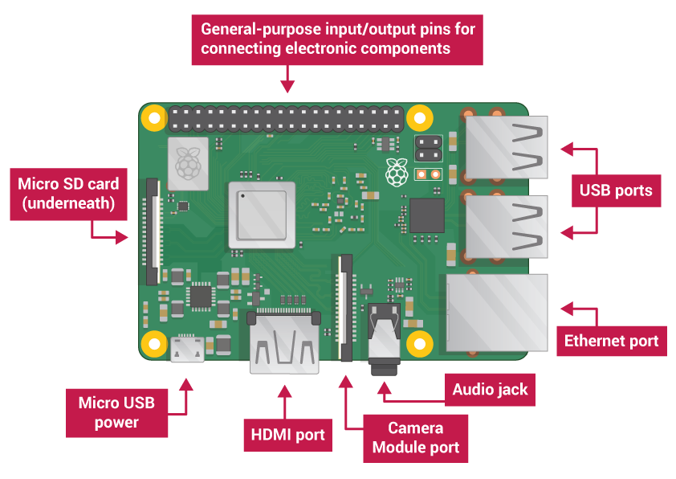
BOARD DESCRIPTION

Slide 10
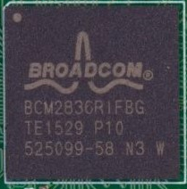
64-bit quad-core ARMV8 Broadcom BCM 2837 CPU 1.2GHz
LAN Controller

Slide 11
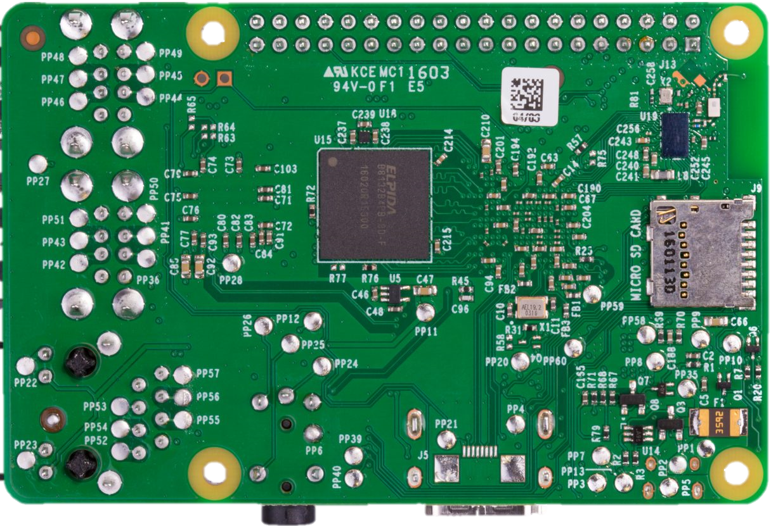
Storage
SD Card Slot

Slide 12
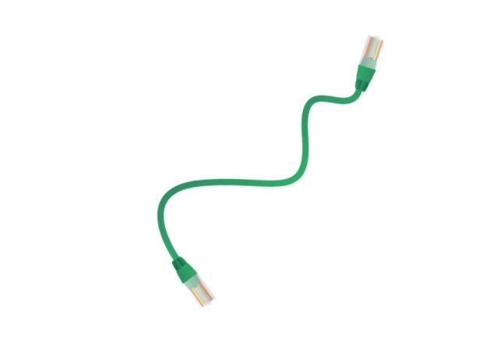
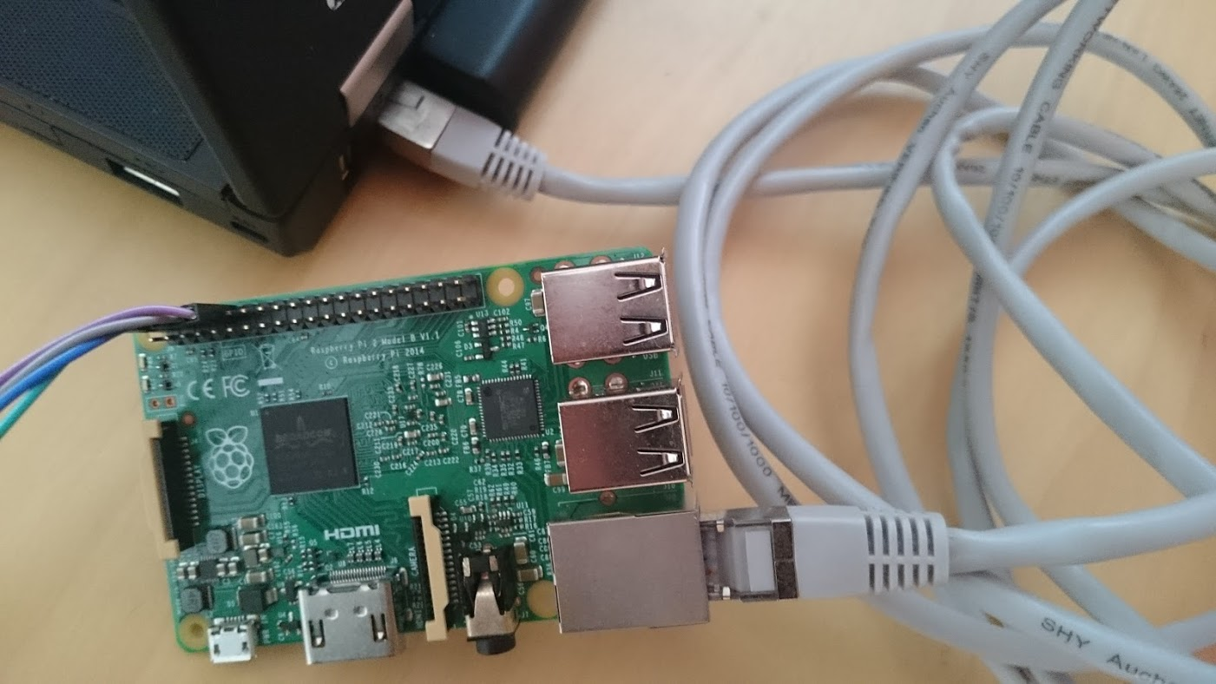
Raspberry Pi Networking-Via Ethernet

Slide 13

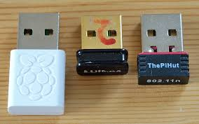
Raspberry Pi Networking-Via WiFi
Raspberry Pi-3 Built in WiFi

Slide 14
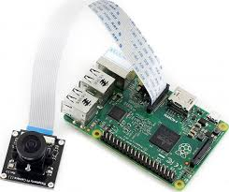
CSI(Camera Serial Interface) Port
The Raspberry Pi has a Mobile Industry Processor Interface (MIPI) Camera Serial Interface Type 2 (CSI-2), which facilitates the connection of a small camera to the main Broadcom BCM2835 processor

Slide 15
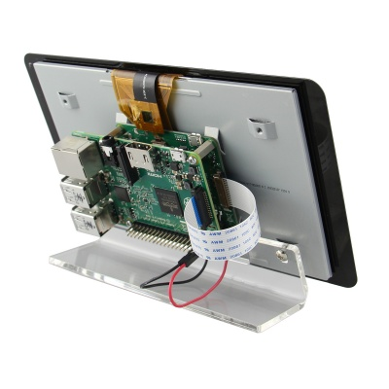
DSI(Display Serial Interface) Port
The Raspberry Pi connector S2 is a display serial interface (DSI) for connecting a liquid crystal display (LCD) panel using a 15-pin ribbon cable.
The mobile industry processor interface (MIPI) inside the Broadcom BCM2837 IC feeds graphics data directly to the display panel through this connector

Slide 16
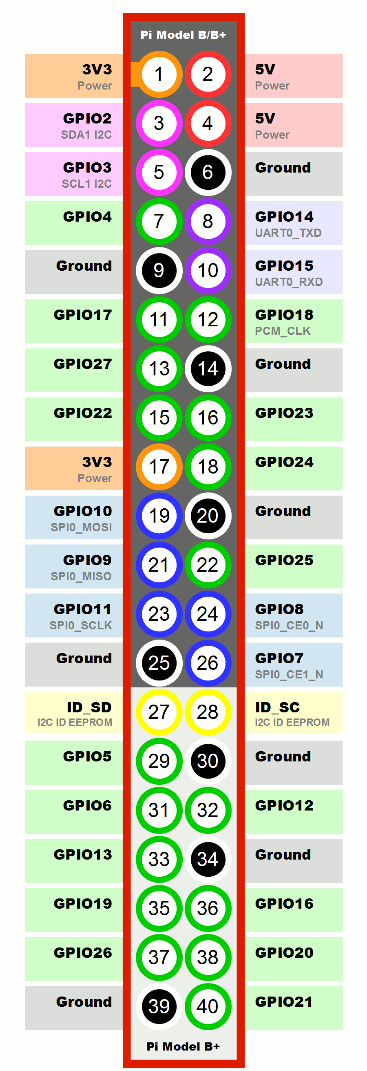
PIN DESCRIPTION

Slide 17
Raspberry Pi Pins
GPIO Pins: 3,5,7,8,10,11,12,13,15,16,18,19,21,22,23,24,26,27,28,29,31,32,33,35,36,37,38,40
GND Pins: 6,9,14,20,25,30,34,39
3.3V Pins: 1,17
5V Pins: 2,4

Slide 18
Equipment Needed to set up Raspberry Pi

Slide 19
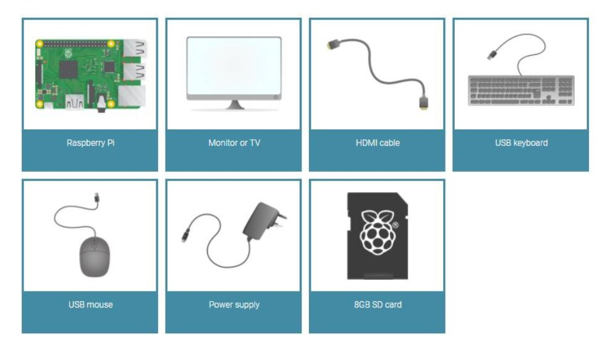
Equipment Needed..
A Monitor with VGA/HDMI cable
Power supply
USB Keyboard and Mouse
SD Card

Slide 20
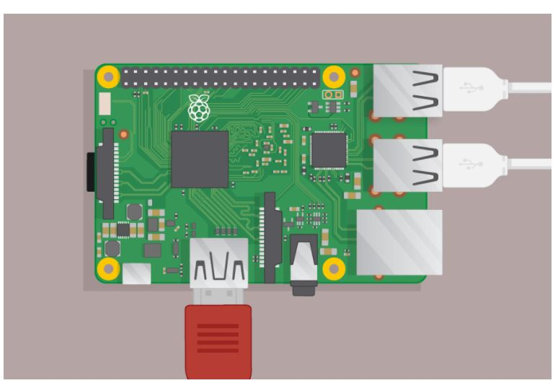
Setup..

Slide 21
Software setup..
Select the Operating System
Download the Operating system
Format SD card
Burn(Flash) the SD card

Slide 22
Operating system
NOOBS
Raspbian
Raspberry Pi Desktop
Thirty Party operating system-Ubuntu Mate
-Windows IoT core
-PINET
-RISC OS

Slide 23
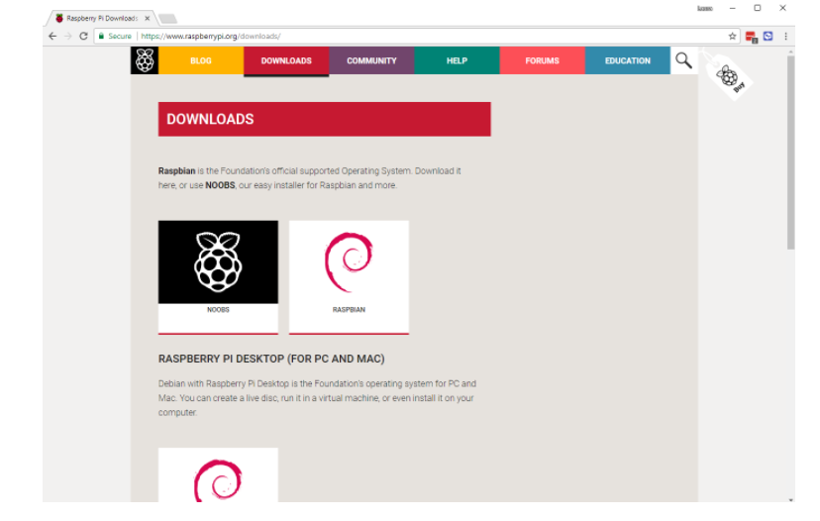
Operating systems included in NOOBS are
Raspbian
Pidora
LibreELEC
OSMC
RISC OS
Arch Linux

Slide 24
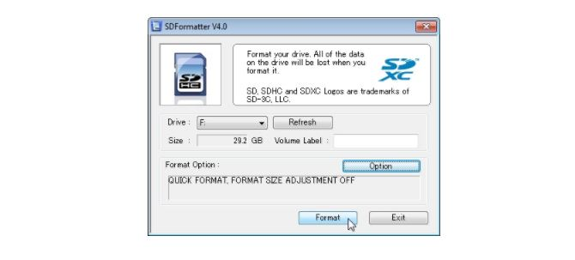
Format SD card…
Sdcard.org->Download SD card formatter
Install the software

Slide 25
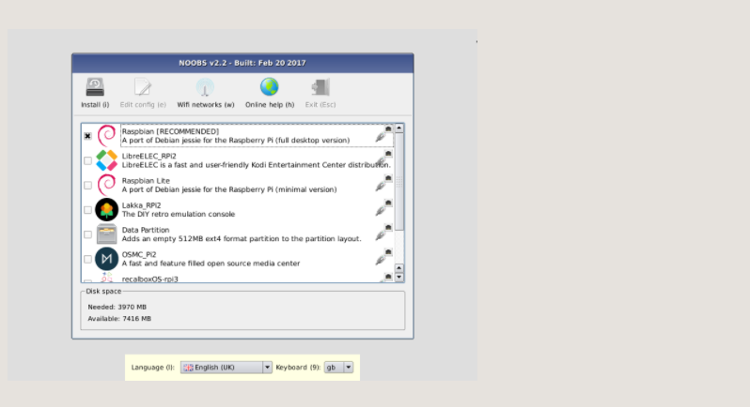
NOOBS(New Out of Box Software)
NOOBS—NOOBS
-NOOBS LITE

Slide 26

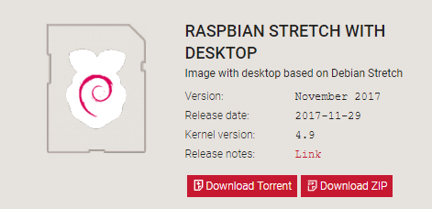
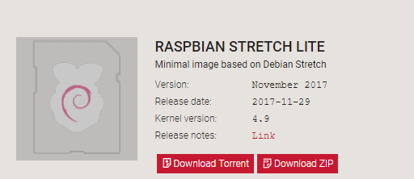
RASPBIAN
RASPBIAN STRETCH WITH DESKTOP
RASPBIAN STRETCH LITE

Slide 27
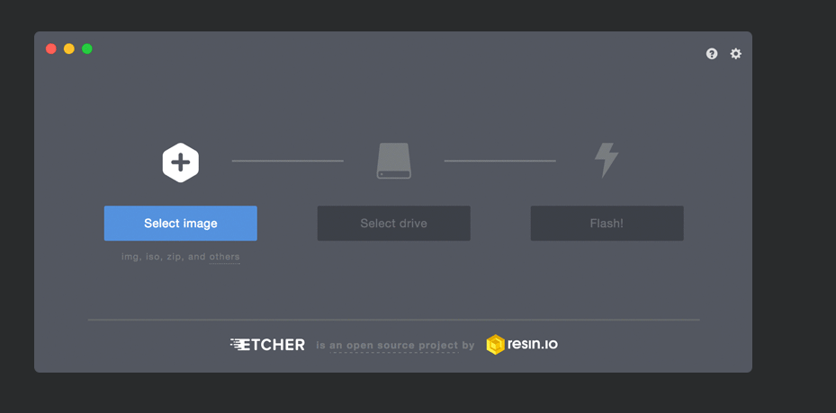
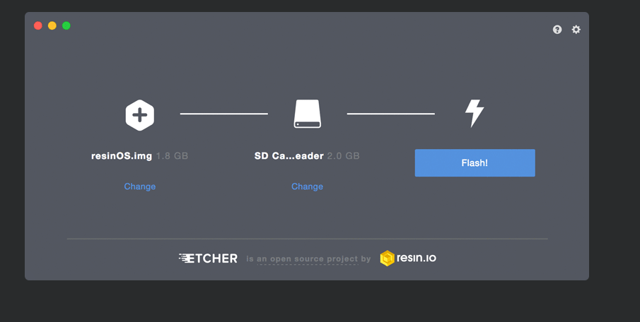
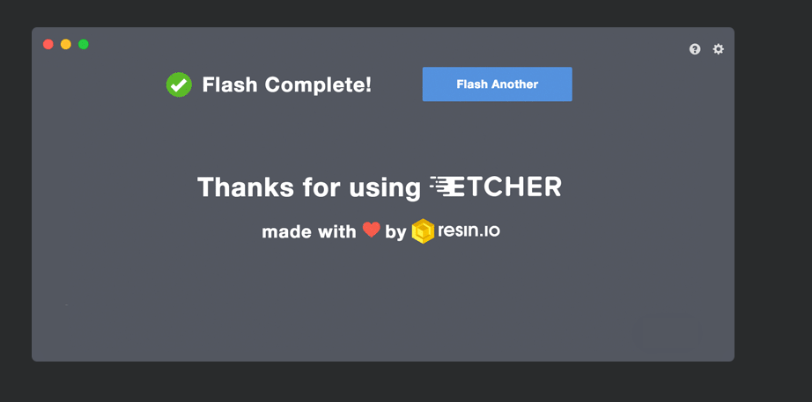
BURN(FLASH) O.S
ETCHER-Software(etcher.io)

Slide 28
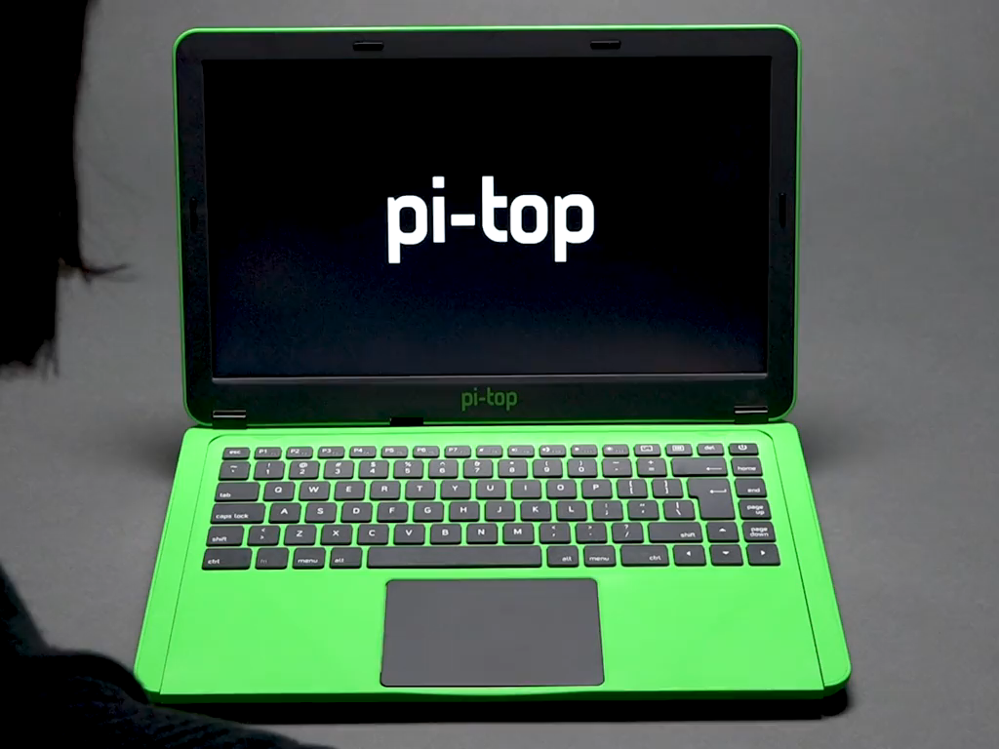
Pi-top

Slide 29


